Slide 1

Internity Foundation Machine Learning Project on
Face Recognition using Transfer Learning

Slide 2
Contents
SNo. | Topic | SlideNo.
1 | Data Collection | 3
2 | Code Used for Capturing Images | 4
3 | Dataset Preparation | 5
4 5 6 | Model Training Model Training using VGG16 (Transfer Learning) Model Training using MobileNet (Transfer Learning) | 6 7-12 13-17
7 8 9 10 11 | Model Prediction Loading the Model Prediction Code VGG16 model prediction MobileNet Model Prediction | 18 19 20-21 22 23

Slide 3
Data Collection
Data Collection refers to collection of required format and quantity of data needed for training a model .
Most important step in any machine learning project as the performance of model always depends on the data over which it is trained .
Face Recognition requires the data in the form of face images of the people whom we want our model to predict .
Images can be collected from many sources like- Past photographs . Using a code to capture images .
Dataset Collected : Images of all the team members .

Slide 4
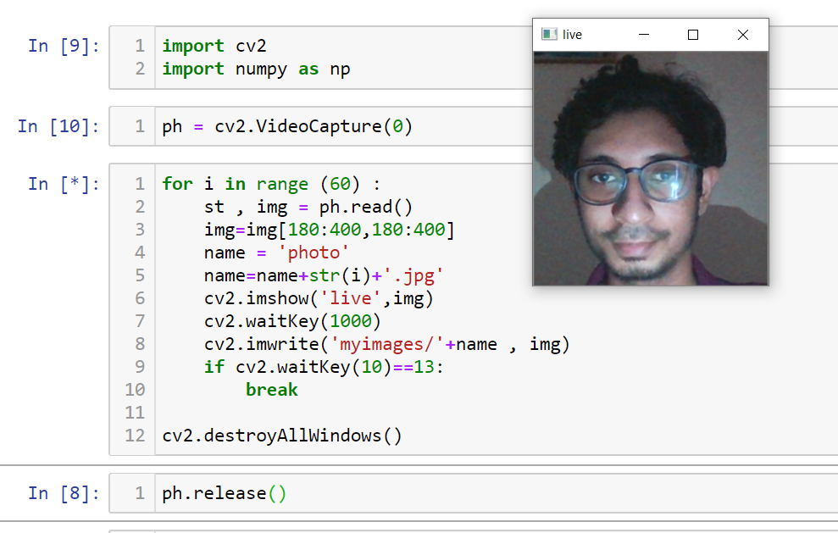
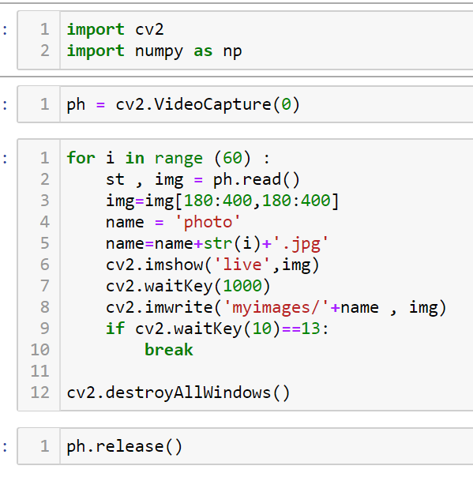
Code used for capturing images
A simple OpenCV (Python library for image processing) code was shared with every team member to execute it in their system .
This code captures 60 images and saves them into a folder .
Fig:1|| Image capture demo screenshot

Slide 5
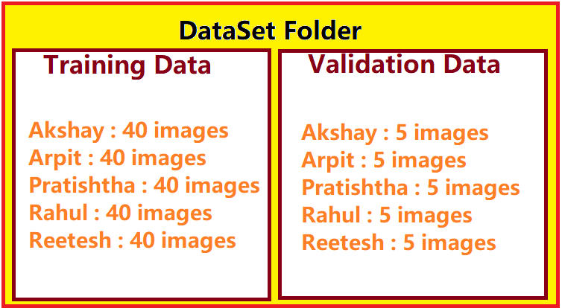
Dataset Preparation
Whole Dataset is divided into Training and Validation Data.
Training Data : 200 images(40 images/person)
Validation Data : 25 images(5 images/person)
Fig:2 || Dataset Folder

Slide 6
Model Training
Concept Used : Convolutional Neural Networks (CNN)
IDE : Google Colaboratory
Training Approach : Transfer Learning using pre-created ConvNet
ConvNets Used : Vgg16 and MobileNet

Slide 7
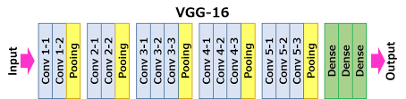
Model Training Using VGG16 (Transfer Learning)
VGG16 is a pre-trained CNN Model containing 16 weighted Training Layers . This model is pre-trained to detect objects in an image , belonging to 1000 Classes or 200 object categories.
Following is the diagrammatic representation of VGG16 model -
Fig:3 || VGG16

Slide 8
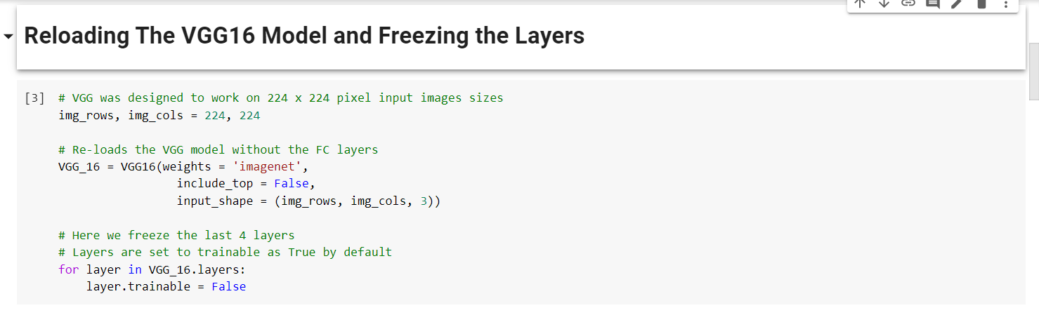

Slide 9
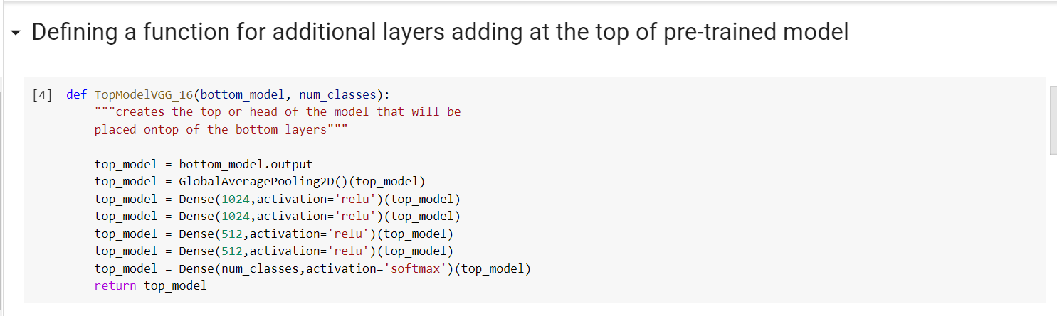

Slide 10
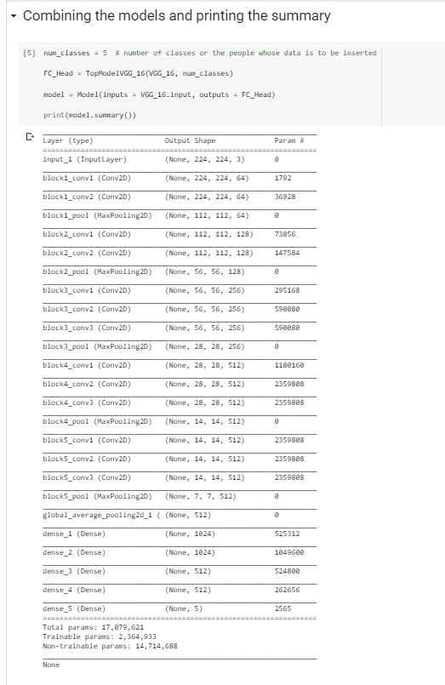
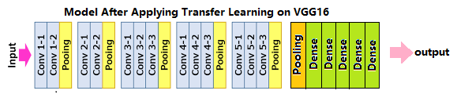

Slide 11
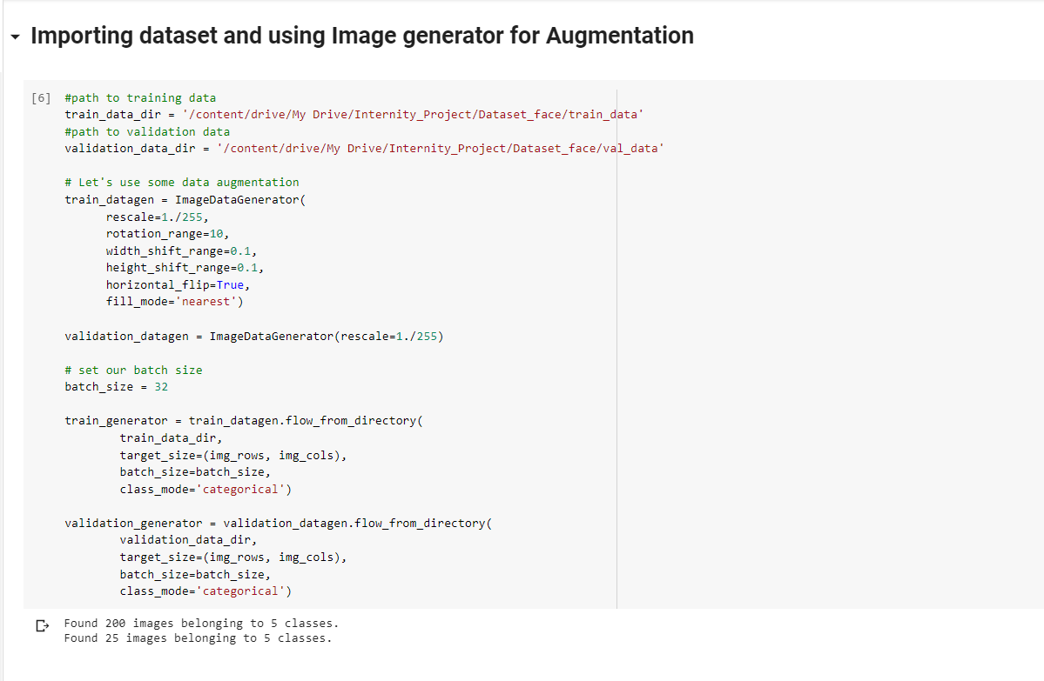

Slide 12
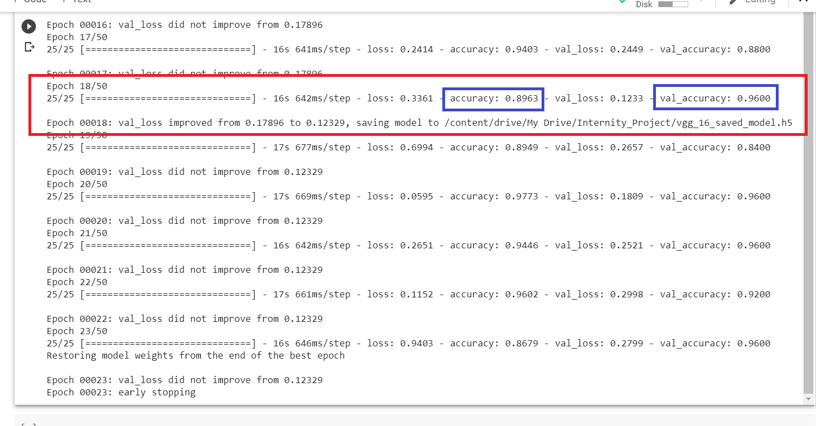

Slide 13
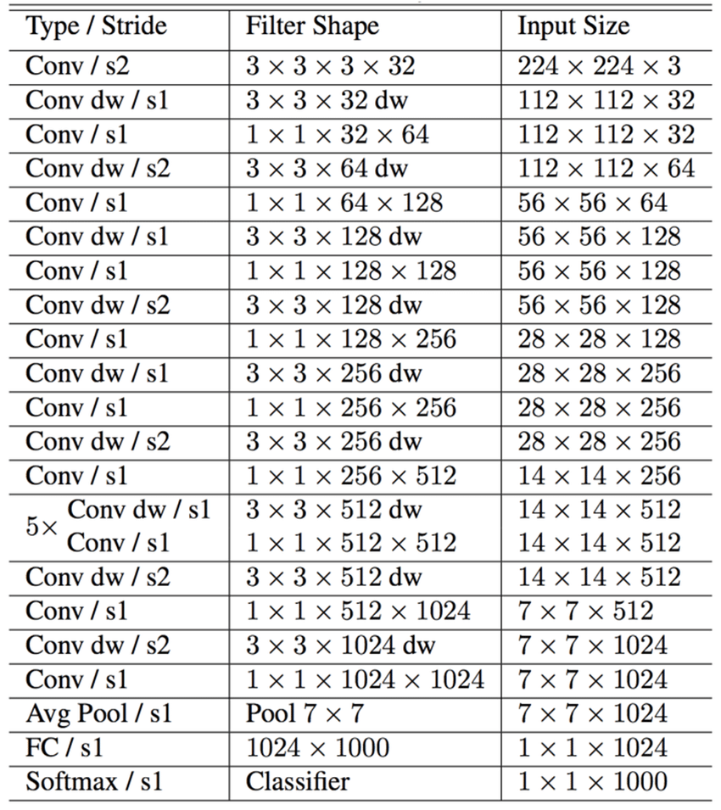
2. Model Training using MobileNet
MobileNet is a CNN architecture model for Image Classification.
MobileNet requires very less computation power to run or apply transfer learning.

Slide 14
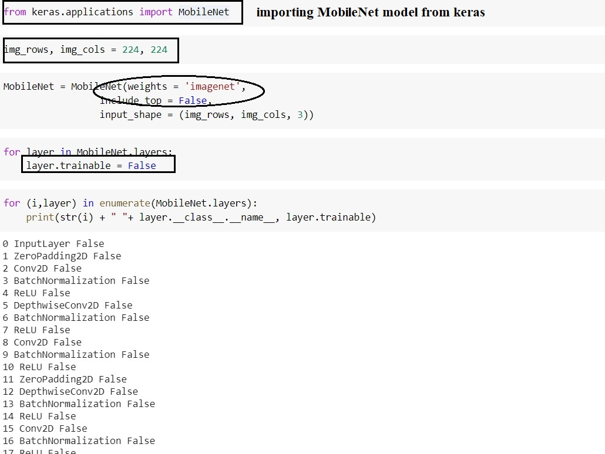
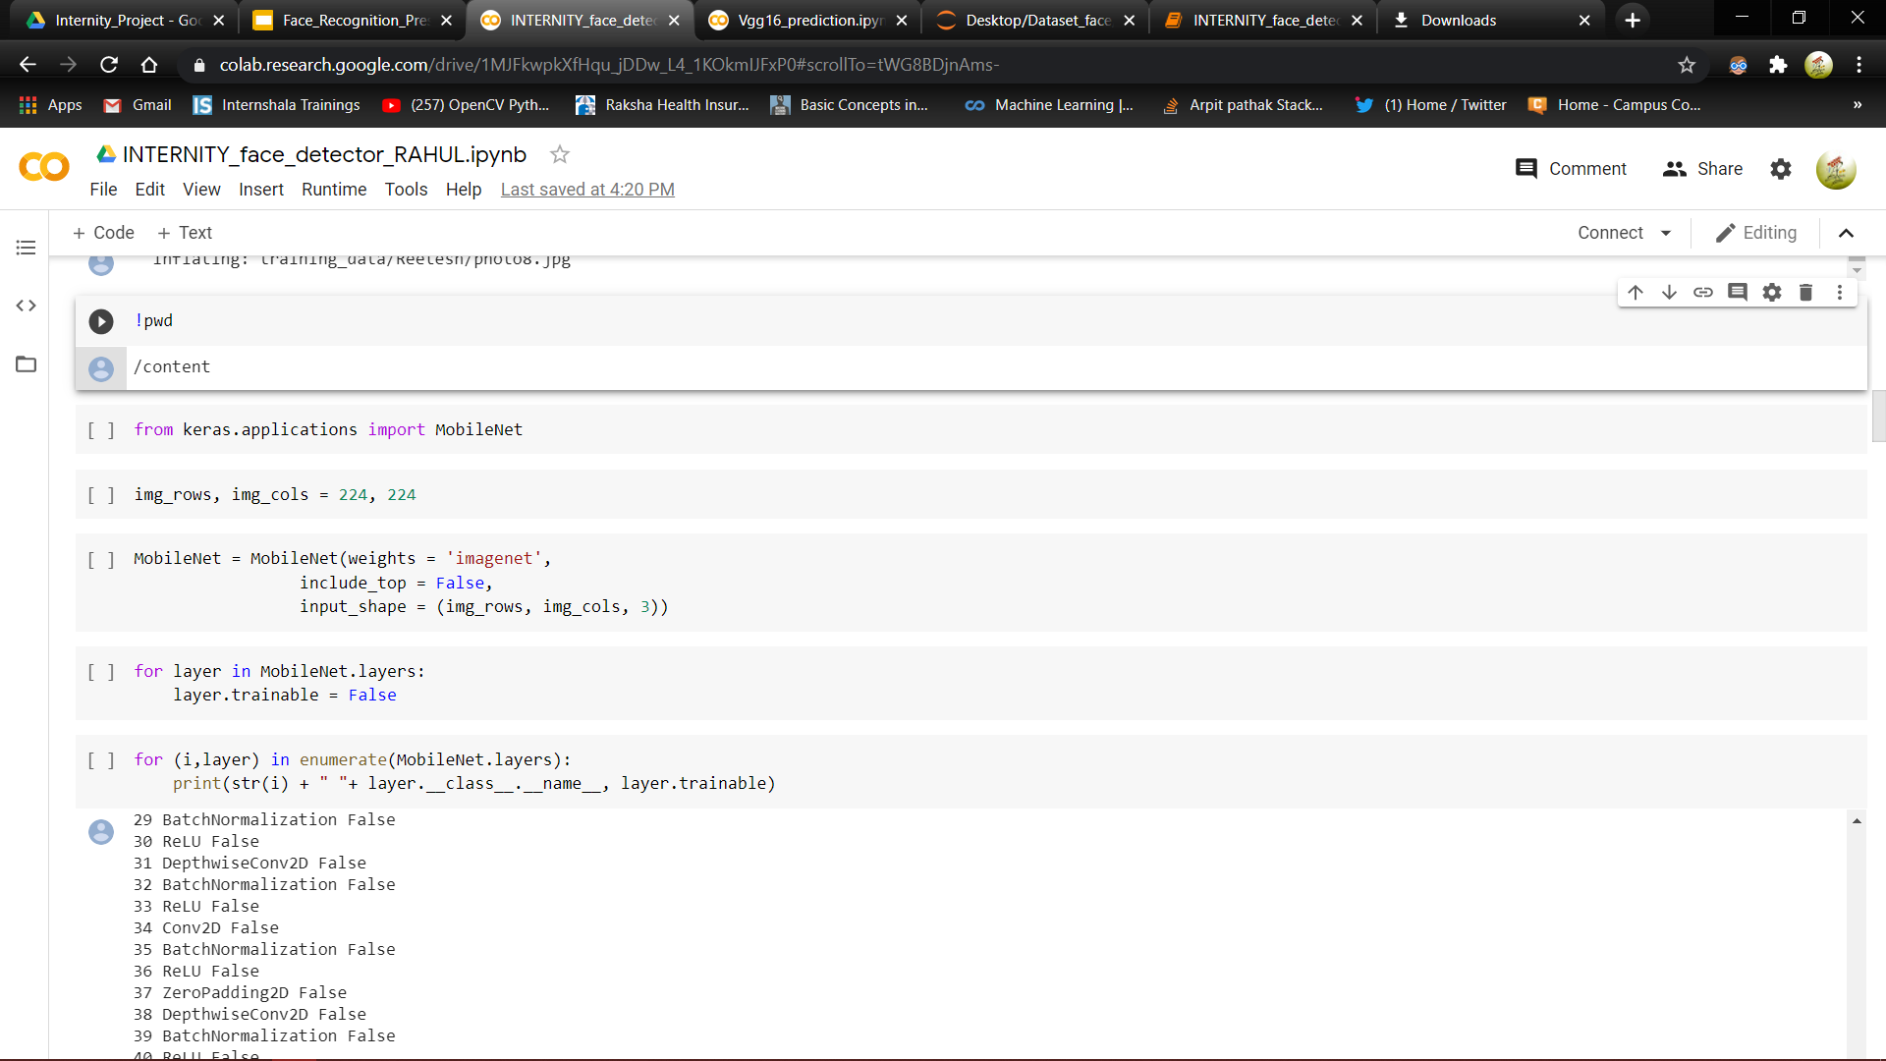
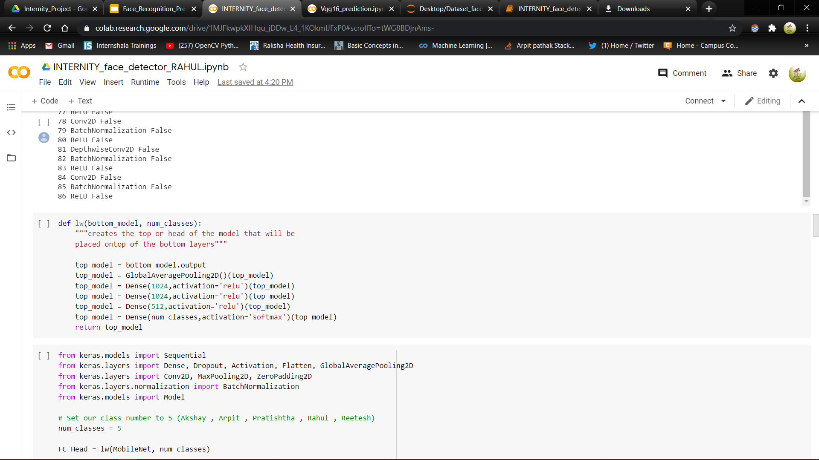
Code Section (part-1)

Slide 15
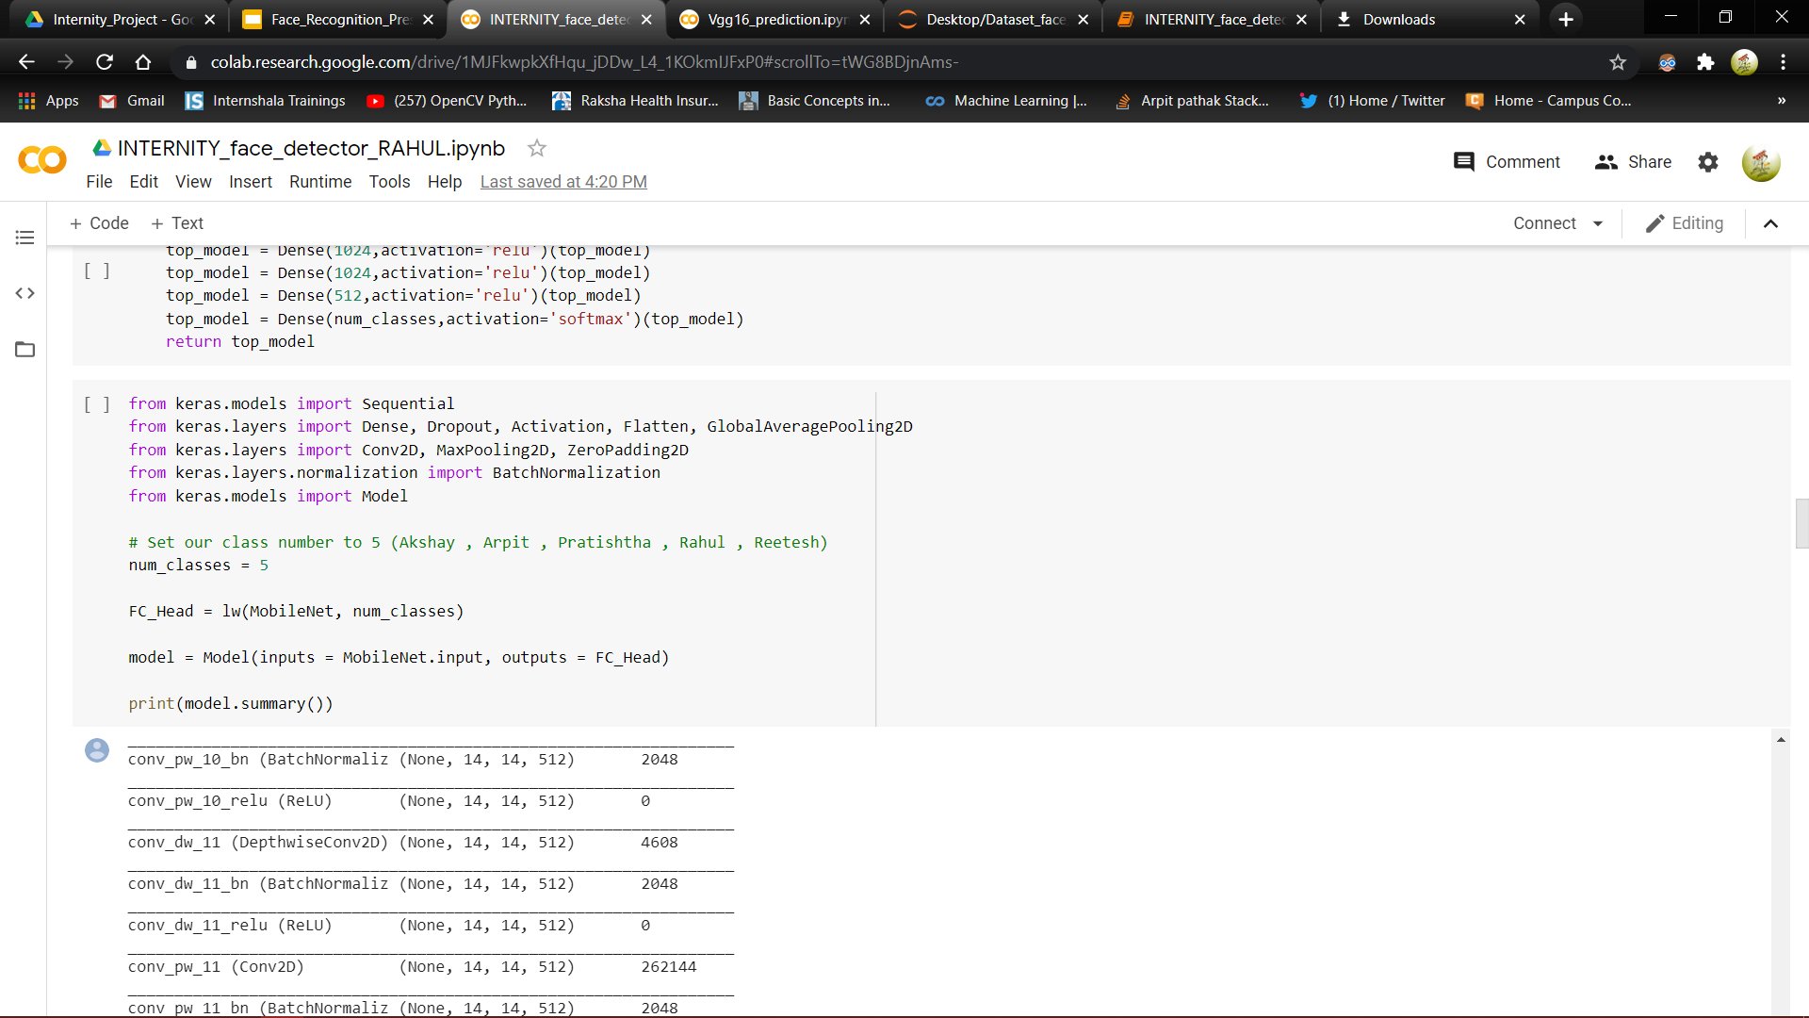
Code Section (part-2)

Slide 16
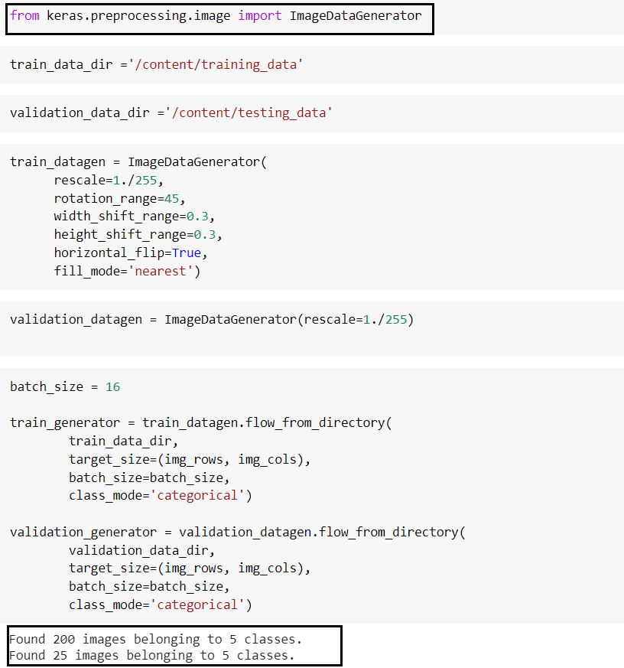
Importing dataset and image generator for image Augmentation

Slide 17
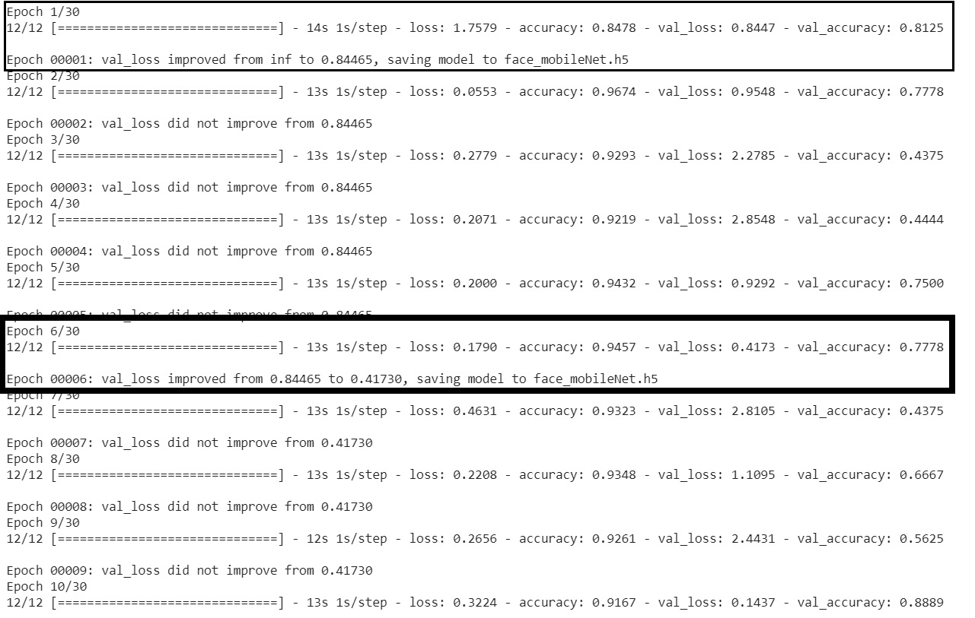
Epoch and Accuracy of MobileNet

Slide 18
Model Prediction
IDE : Google Colaboratory
Prediction Type : Image Prediction
Prediction Data Details : 5 Classes (2 images belonging to each class)

Slide 19
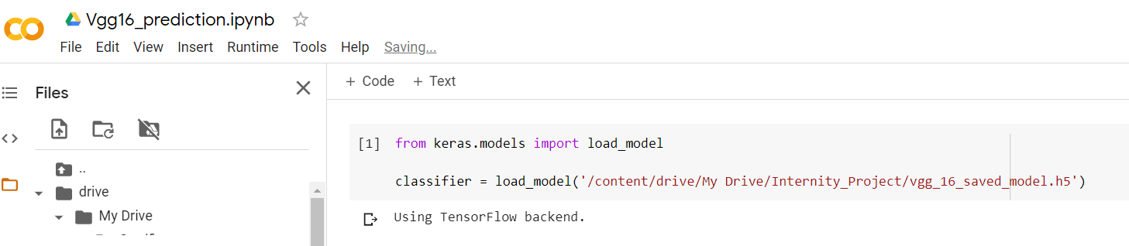
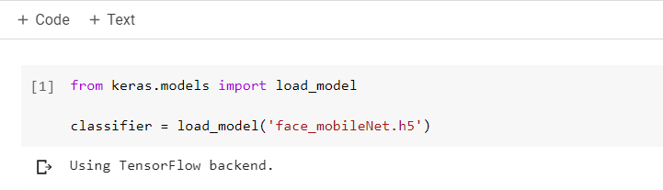
Loading the Model
V
Vgg16 import
Mobilenet Import

Slide 20
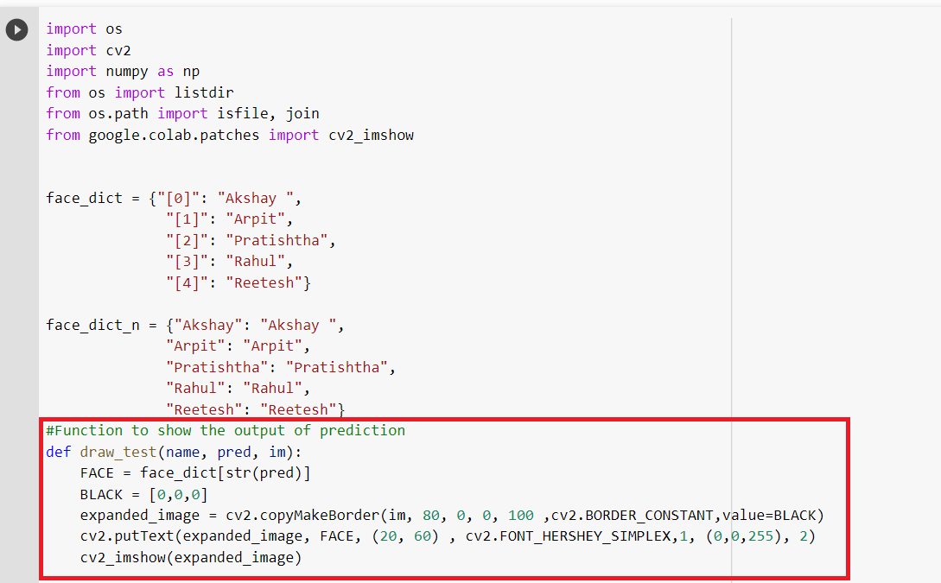
Prediction Code (part 1)

Slide 21
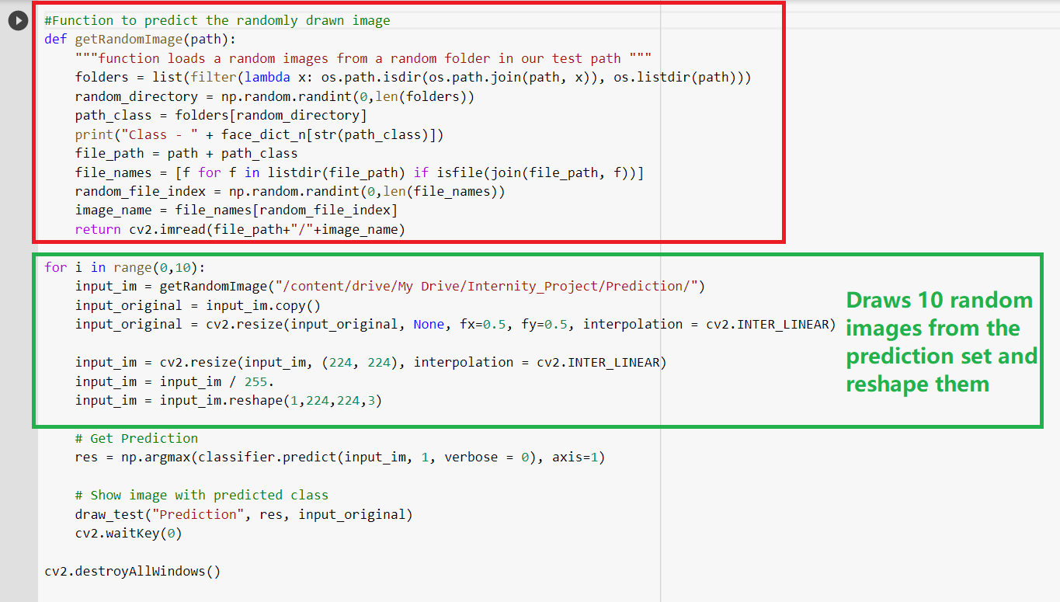
Prediction Code (part 2)

Slide 22
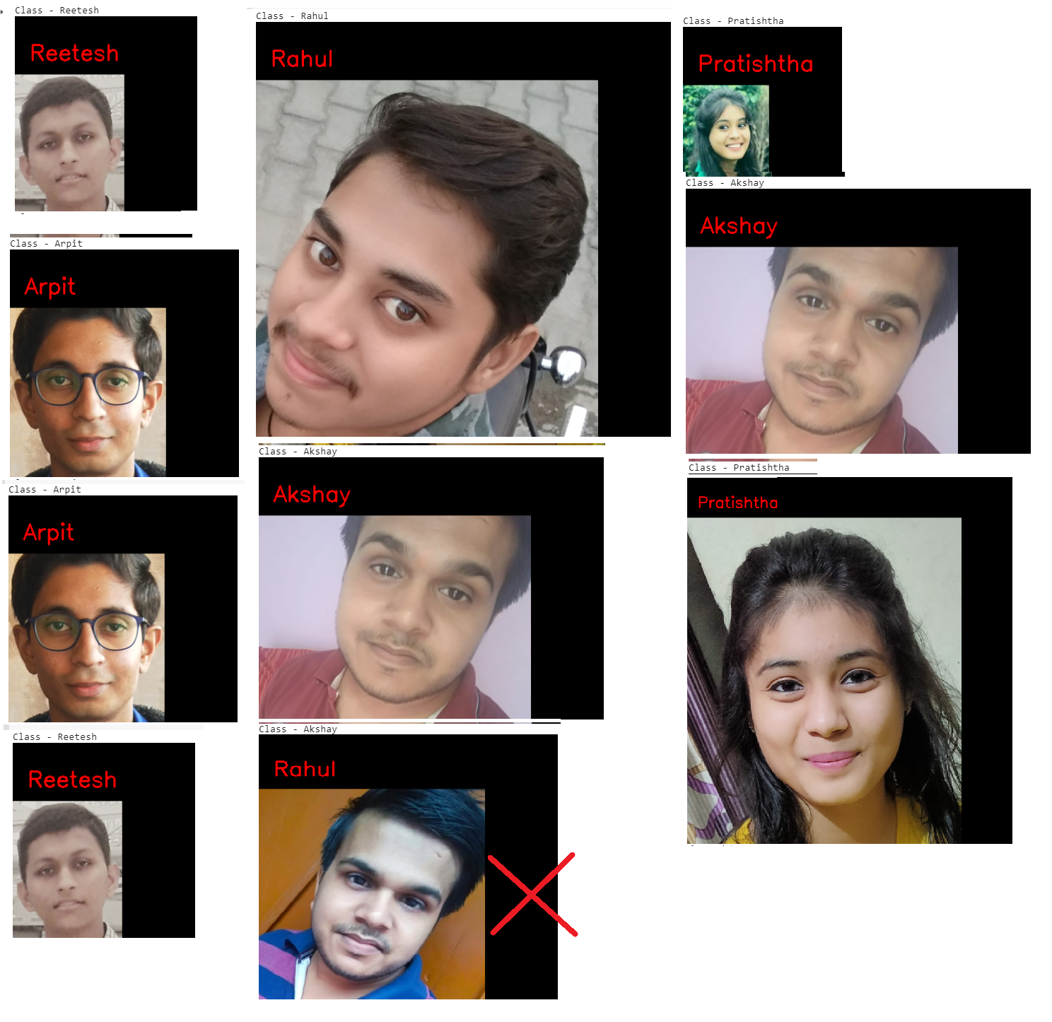
Output from VGG16 model

Slide 23
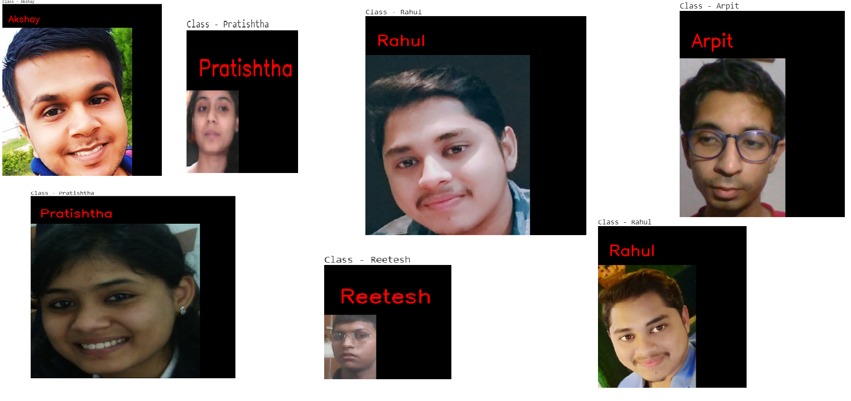
Output from MobileNet model

Slide 24
Team Details
Name | Email ID
Rahul Rastogi | rahulrastogi1104@gmail.com
Akshay Maheshwari | akshay26072000@gmail.com
Reetesh Kumar | reetesh.umrao@gmail.com
Pratishtha Agarwal | pratishtha013@gmail.com
Arpit Pathak | arpitpathak114@gmail.com

Slide 25
THANK YOU

